Slide 1
Migrate to database step-by-step
Cifeng Fang
08/22/2022

Slide 2
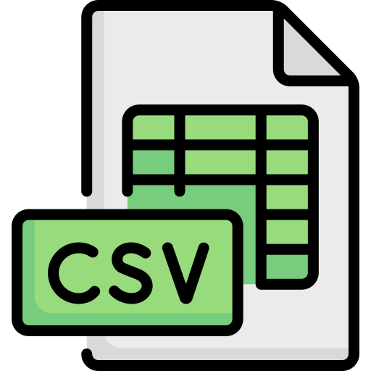
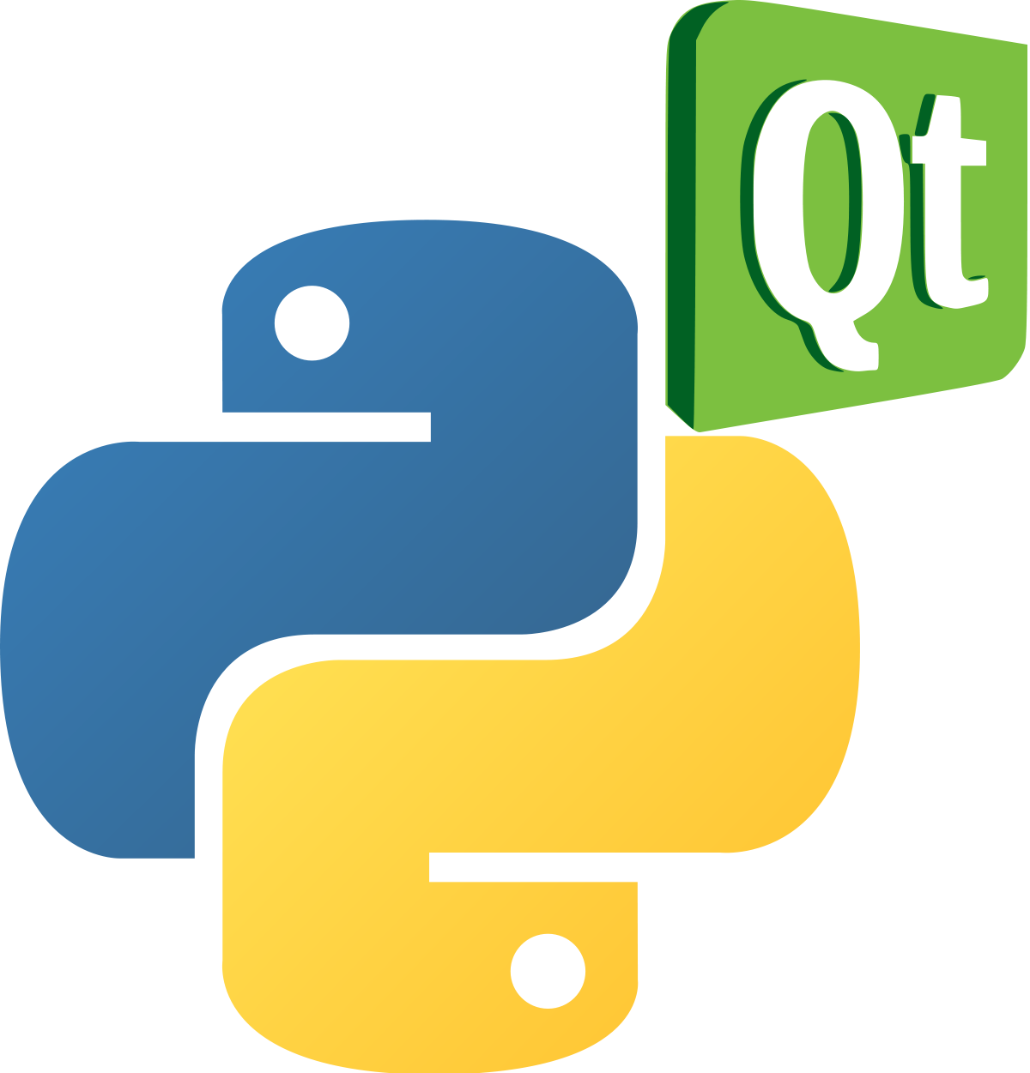

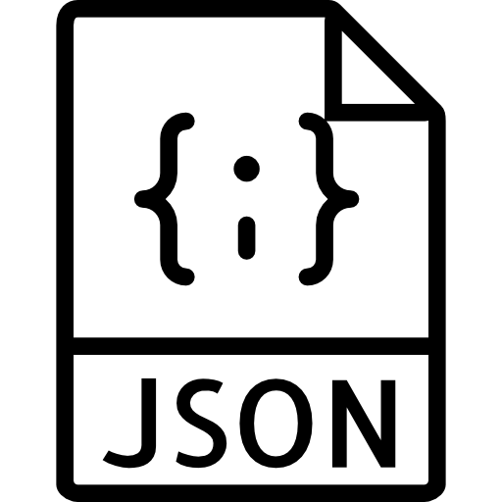
Desktop-based solution-in-house use/feedback collection
Local host MongoDB server and NoSQL database
Develop backend processing script to transfer raw csv data to JSON file
Import JSON file to NoSQL database
Develop pyqt5 desktop app to interact(CRUD, visualized etc.) with database and export the database in JSON
Desktop frontend
NoSQL database
Backend processing

Slide 3
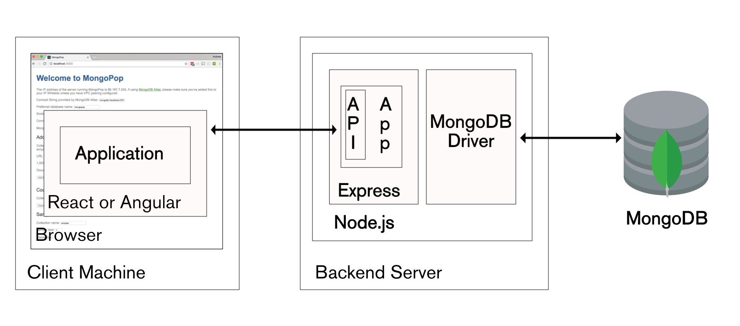
Cloud-based solution- with scalability maintainability considered
Deploy the backend server and MongoDB driver on choice of cloud
Switch the desktop client frontend to web based

Slide 4
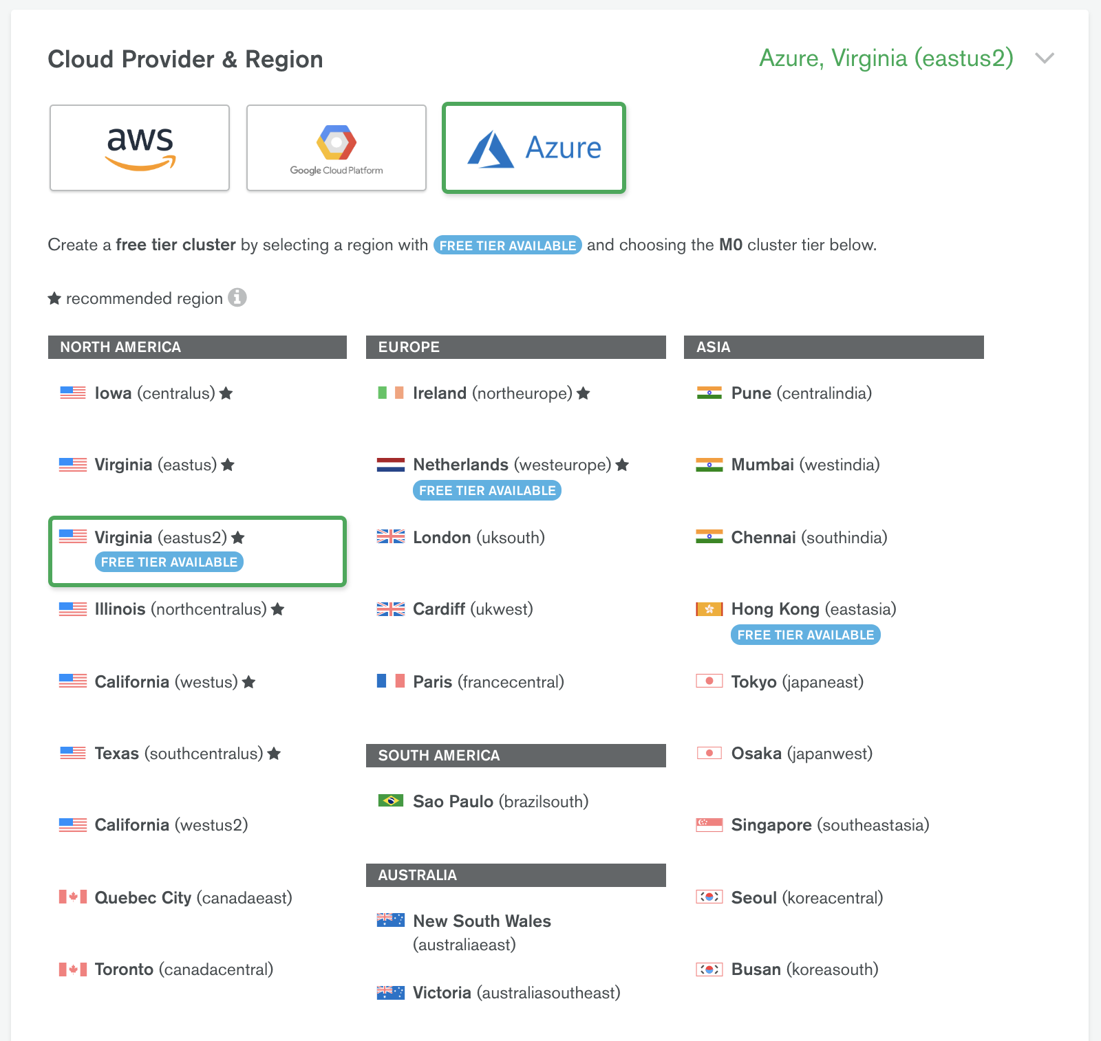
MongoDB Atlas
Has free tier cluster (512MB) on AWS, GCP and Azure
Identical operation process compared to localhost version MongoDB
Has capability of importing database via JSON file

Slide 5
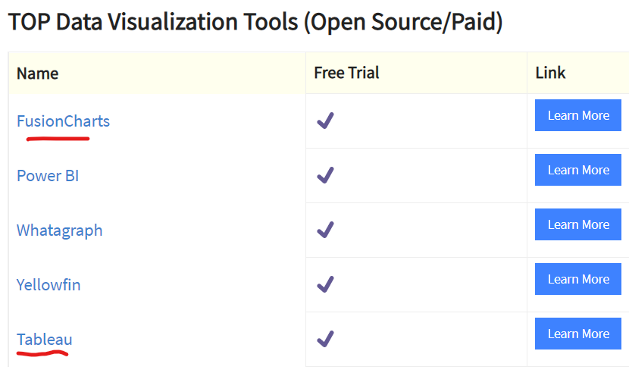
Data visualization services
Once free tier MongoDB Atlas was setup and with JSON file with test results deploy to cloud database,
Various cloud-based data visualization tools will be tested, and an evaluation of each choice will be given to help us decide which tool suit our needs most

Slide 6
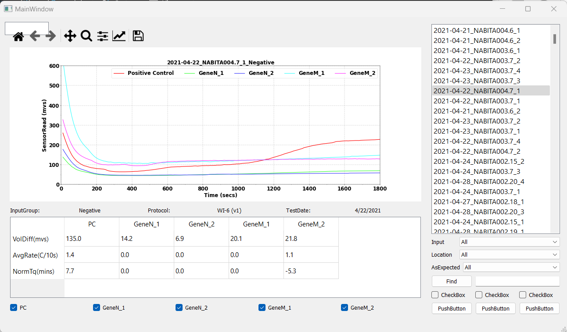
Features planning for the dashboard app
Tests querying
filtering widget
Data visualization widget
Test info section
Toggle curve on/off
Action widget
(place holder)

Slide 7
Current progress
Script to combine csv files (raw run data + testlog_S2R) to JSON file
Construct MongoDB collection from JSON file (both successfully test on localhost and Atlas)
Python Qt desktop dashboard app to interact with MongoDB
Data visualization widget
Tests querying and filtering widget
User action widget
Etc..

Slide 8
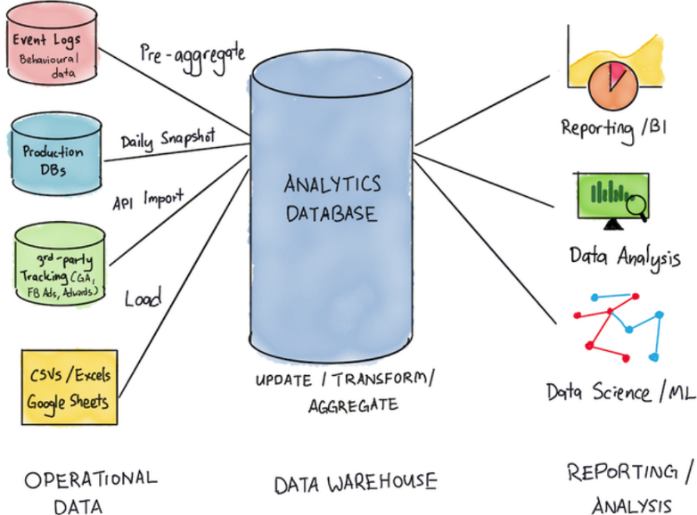
Database configuration-full picture

Slide 9
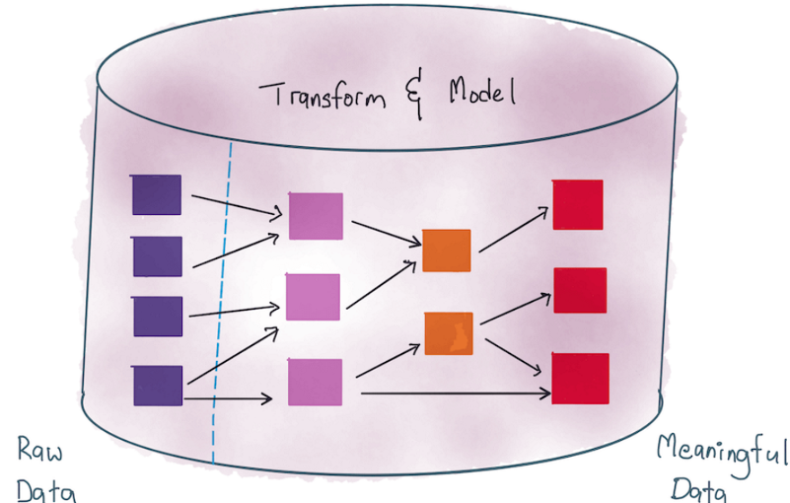
Data engineering needed before analysis

Slide 10
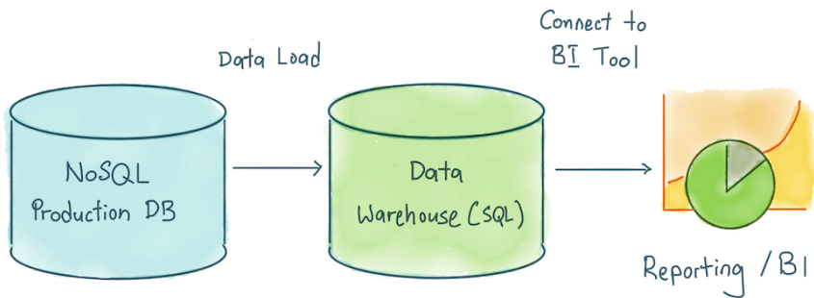
Concept of NoSQL-SQL hybrid setup

Slide 11
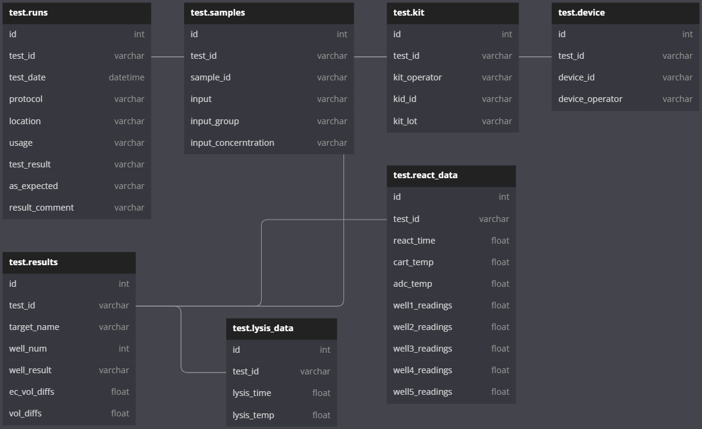
Data schema for test log database (SQL)

